Slide 1
Iterators, generators and asyncio in Python 3
Sergii Tishchenko
github link: https://tishyk@bitbucket.org/tishyk/demos.git

Slide 2
What is iterator?
How and where we can use it?
What is generator?
Yield statement
Asynchronous programming with generators
Python concurrent programming without asyncio library
Concurrent programming with asyncio
Coroutine, tasks and event-loops

Slide 3
What is iterator?
Iterators are everywhere in Python. They are elegantly implemented within for loops, comprehensions, generators etc. but hidden in plain sight.
Iterator in Python is simply an object that can be iterated upon. An object which will return data, one element at a time.
Python iterator object must implement two special methods, __iter__() and __next__(), collectively called the iterator protocol.
An object is called iterable if we can get an iterator from it. Most of built-in containers in Python like: list, tuple, string etc. are iterables.
The iter() function (which in turn calls the __iter__() method) returns an iterator from them.

Slide 4
What is iterator? Iterator protocol
There are only a couple of functions specifically for working with iterators.
int PyIter_Check( PyObject *o)
Return true if the object o supports the iterator protocol.
PyObject* PyIter_Next( PyObject *o)
Return value: New reference.
Return the next value from the iteration o.
If the object is an iterator, this retrieves the next value from the iteration, and returns NULL with no exception set if there are no remaining items. If the object is not an iterator, TypeError is raised, or if there is an error in retrieving the item, returns NULL and passes along the exception.

Slide 5
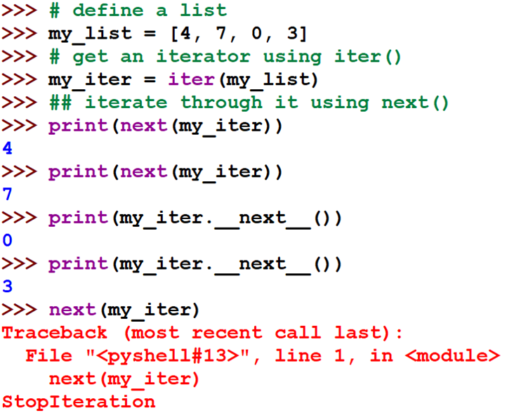
What is iterator? Iterator protocol

Slide 6
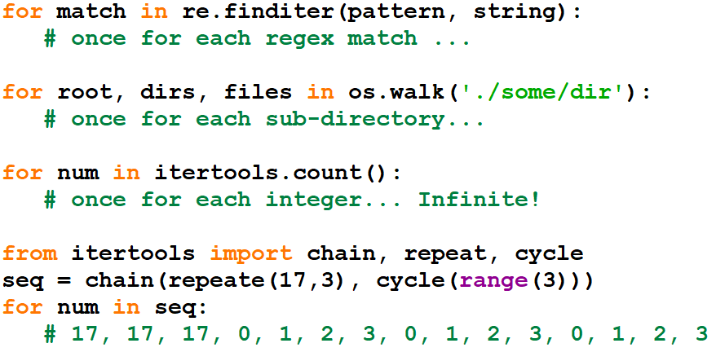
What is iterator? Iterator examples

Slide 7
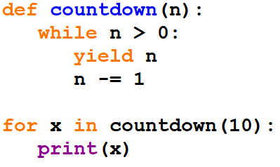
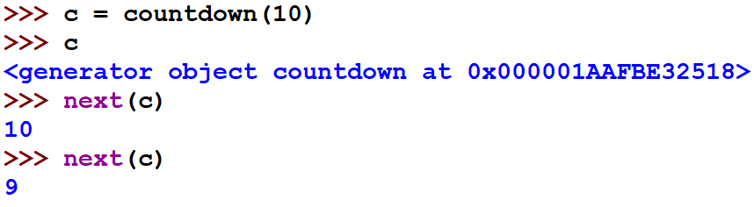
What is generator?
Generator functions are commonly used to feed values to for-loops (iteration).
A generator is a function that returns an object (iterator) which we can iterate over (one value at a time).
Under the covers, the countdown function executes on successive next() calls

Slide 8
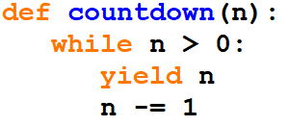
What is generator?
Whenever a generator function hits the yield statement, it suspends execution
Here's the idea : Instead of yielding a value, a generator can yield control
We can write a little scheduler that cycles between generators, running each one until it explicitly yields

Slide 9
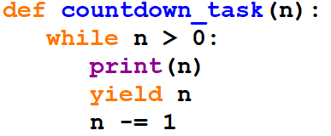
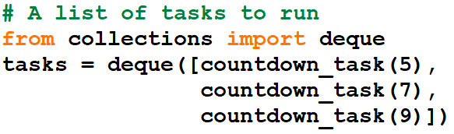
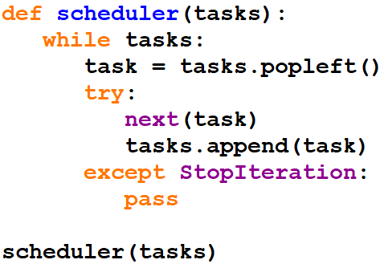
What is generator?
Set up a set of "tasks“
Each task is a generator function
Run a task scheduler
This while loop is what drives the application between 3 tasks
Generator is a way to control flow between different tasks and run it concurrent

Slide 10
Asynchronous programming with generators. What for?
I/O is high latency
Sequential programs waste resources waiting on I/O
Multithreading/multiprocessing carry
Large resource overheads
Large cognitive overheads
Python interpreter is shared mutable state protected by Global Interpreter Lock
Make a single Python process run as fast as possible without any thread/process overhead

Slide 11
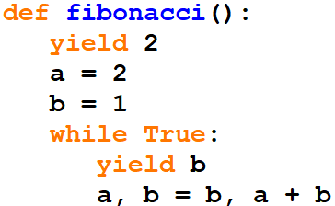
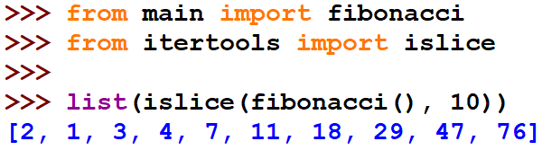
Asynchronous programming with generators. Fibonacci sequence

Slide 12
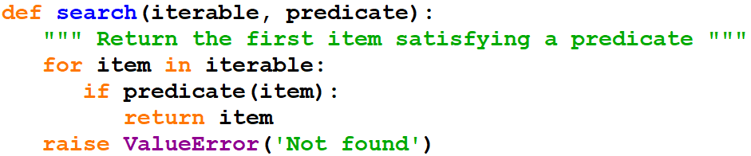

Asynchronous programming with generators. Linear search

Slide 13
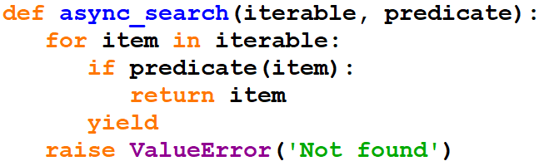
Asynchronous programming with generators. Cooperative search 1

Slide 14
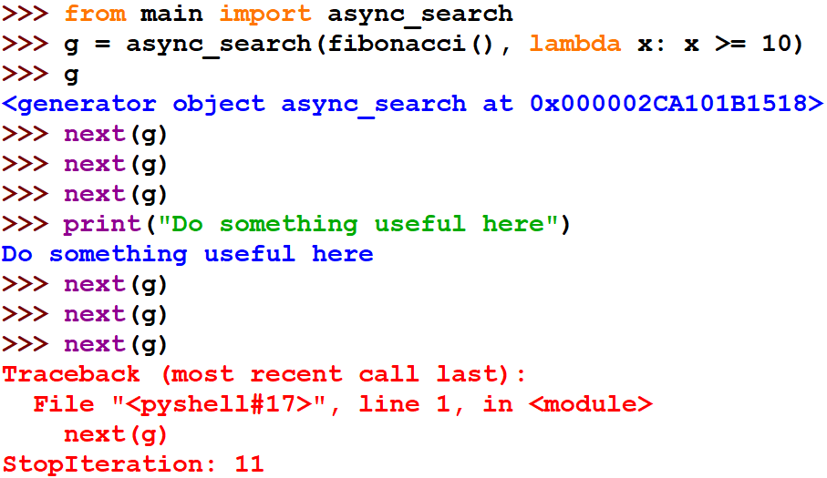
Asynchronous programming with generators. Cooperative search 2

Slide 15
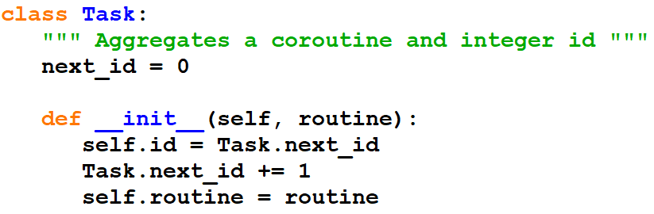
Asynchronous programming with generators. Task

Slide 16
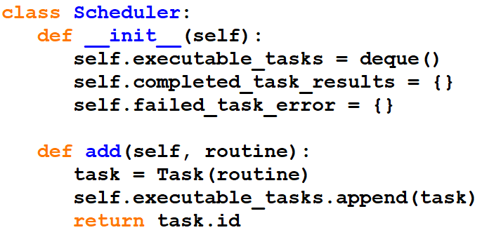
Asynchronous programming with generators. Scheduler 1

Slide 17
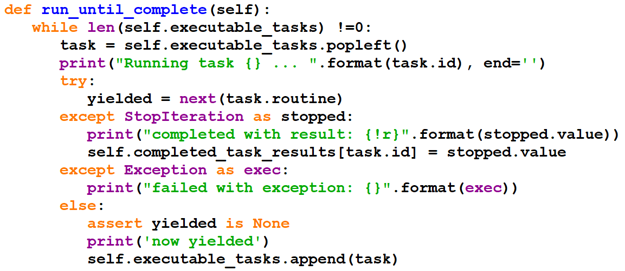
Asynchronous programming with generators. Scheduler 2

Slide 18
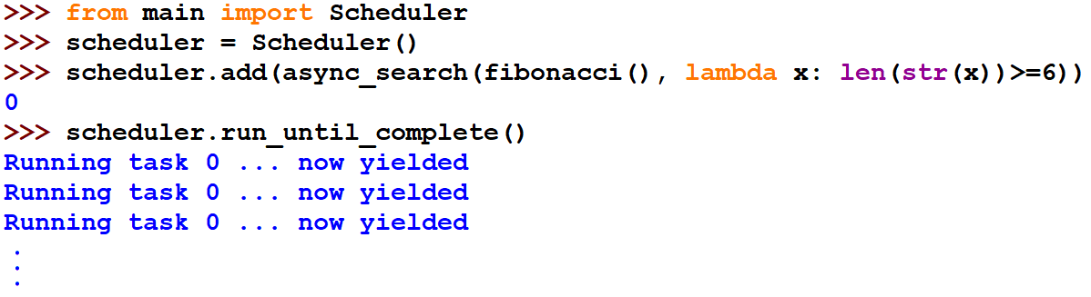
Asynchronous programming with generators. Task execution

Slide 19
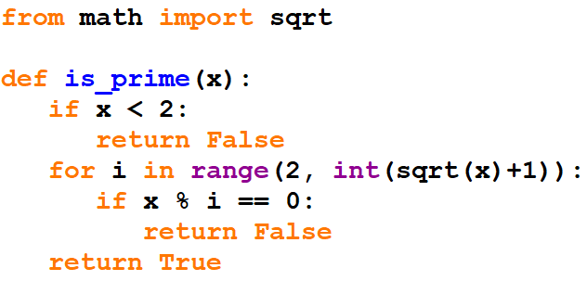
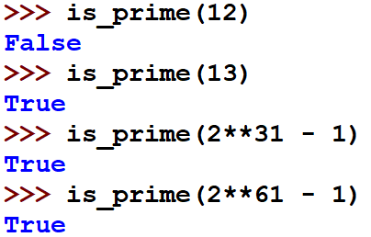
Asynchronous programming with generators. Blocking task
Simple but inefficient with long numbers

Slide 20
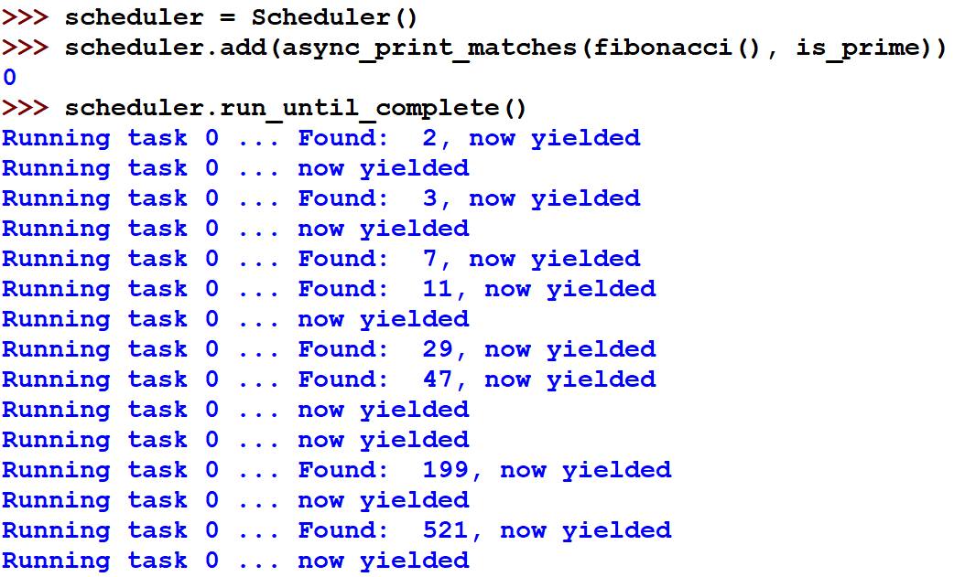
Asynchronous programming with generators. Blocking task

Slide 21
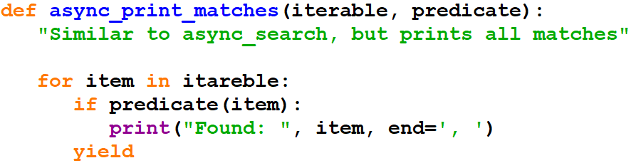
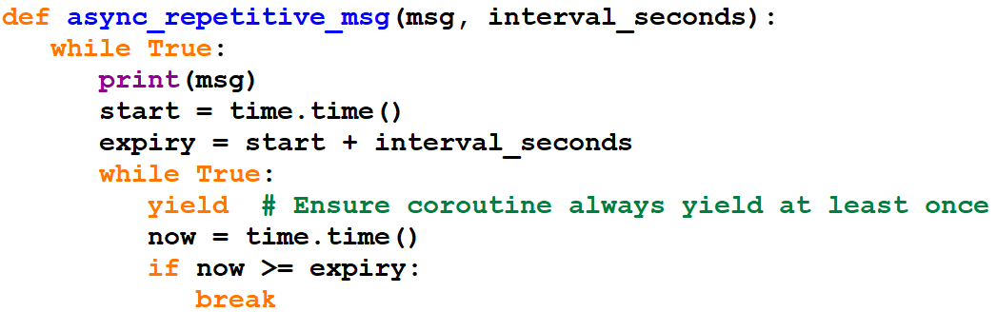
Asynchronous programming with generators. Blocking task

Slide 22
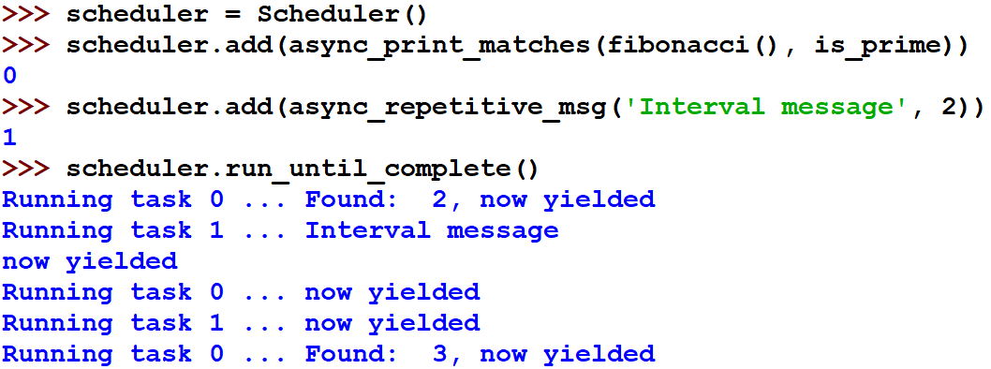
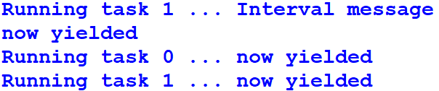
Asynchronous programming with generators. Blocking task

Slide 23
Asynchronous programming with generators. Blocking task
Everything you call -transitively- from a coroutine should be
non-blocking.
Coroutines are contagious to callees.

Slide 24
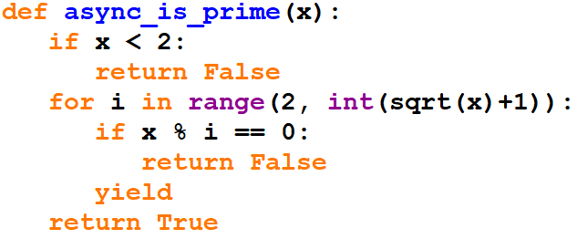
Asynchronous programming with generators. Non-blocking task
Return a bool
Return a generator object

Slide 25
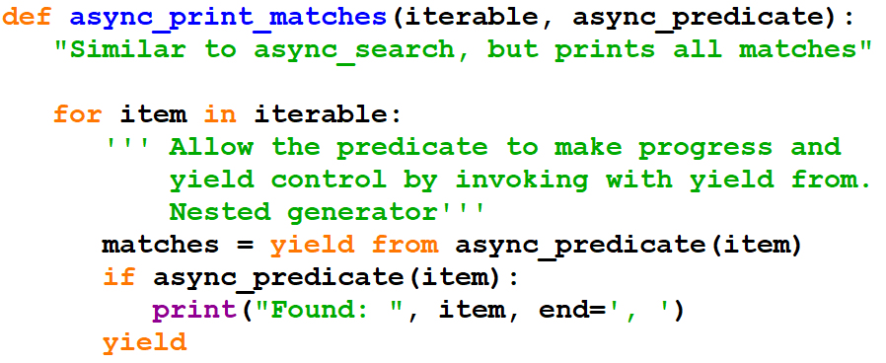
Asynchronous programming with generators. Non-blocking task
generator object
no longer needed

Slide 26
Asynchronous programming with generators. Non-blocking task
Everything that call – transitively - to a coroutine must iterate
the generator.
Coroutines are contagious to callers.

Slide 27
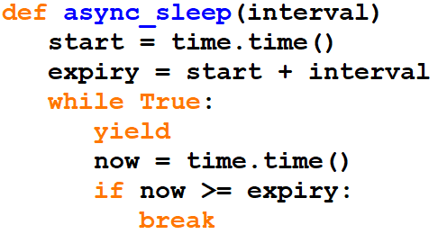
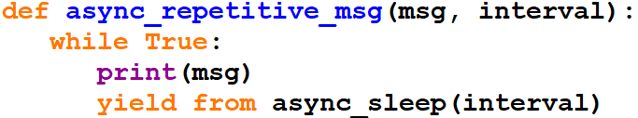
Asynchronous programming with generators. Refactoring

Slide 28
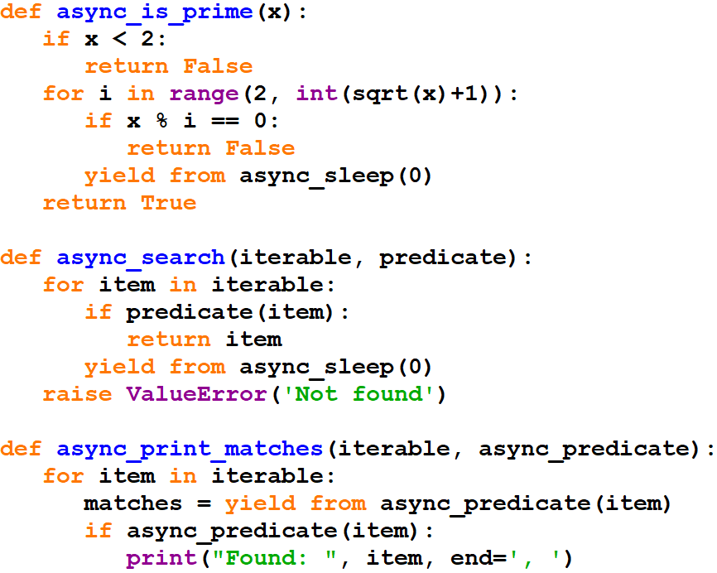
Asynchronous programming with generators. Refactoring

Slide 29
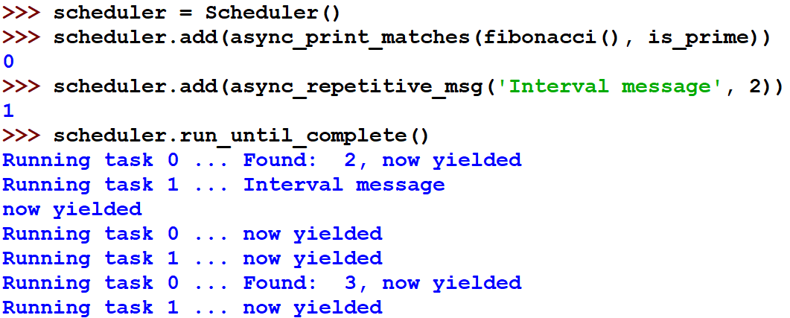
Asynchronous programming with generators. Refactoring

Slide 30


Concurrent programming with asyncio. Definitions 1
Concurrency
Tasks start, run, and complete in
overlapping time periods
asyncio
Parallelism
Tasks run simultaneously
Threads/Processes

Slide 31


Concurrent programming with asyncio. Definitions 2
Synchronous(Sequential)
Must complete before proceeding
Overall duration longer
Asynchronous
No need to wait before proceeding
Overall duration shorter

Slide 32

Concurrent programming with asyncio. Definitions 3
Asynchronous
Returns immediately with a promise for the complete result
Callbacks / Futures / Promises
Non-blocking
Returns immediately, with no result, partial result, or complete result
Polling

Slide 33


Concurrent programming with asyncio. Definitions 4
Preemptive multitasking
Scheduler interrupts tasks
Inconvenient context switches
Cooperative multitasking
Tasks yield to scheduler
Uncooperative tasks hang system

Slide 34

Concurrent programming with asyncio
asyncio
Write asynchronous, concurrent, cooperative tasks …
… in a sequential style.
https://upload.wikimedia.org/wikipedia/commons/9/97/12_Armige_Statue.JPG

Slide 35

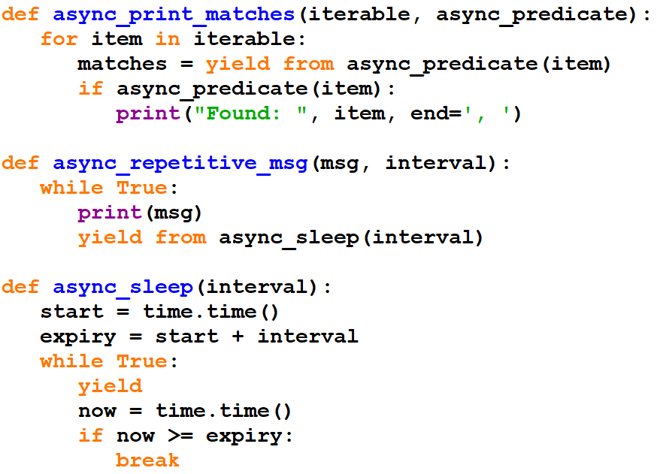
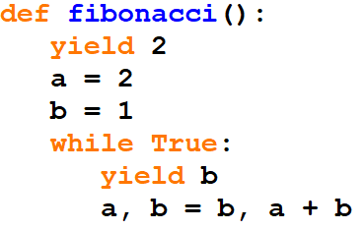
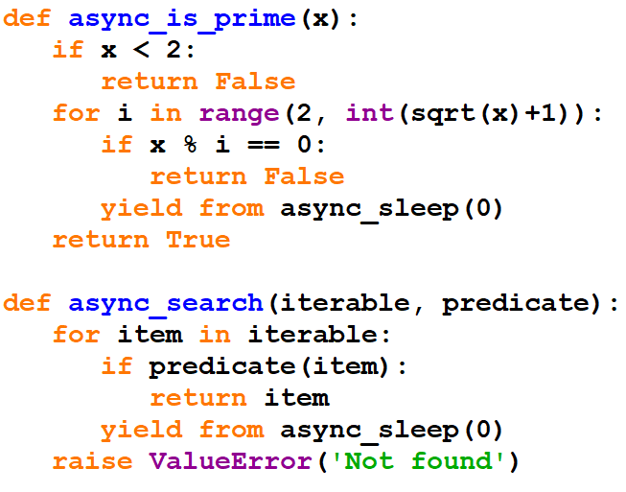
Concurrent programming with asyncio. Refactor to asyncio code 1

Slide 36
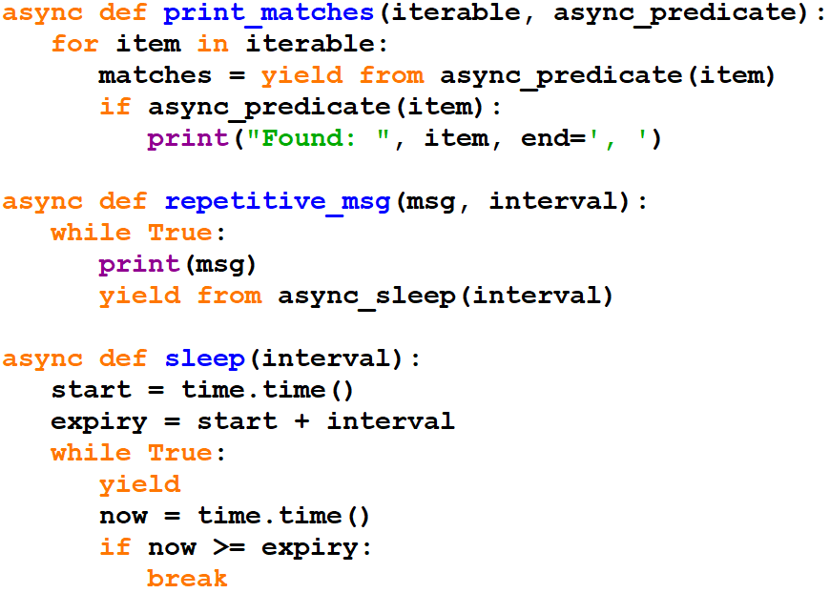


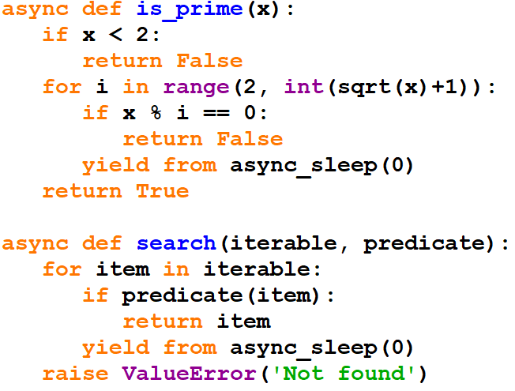




Concurrent programming with asyncio. Refactor to asyncio code 2

Slide 37
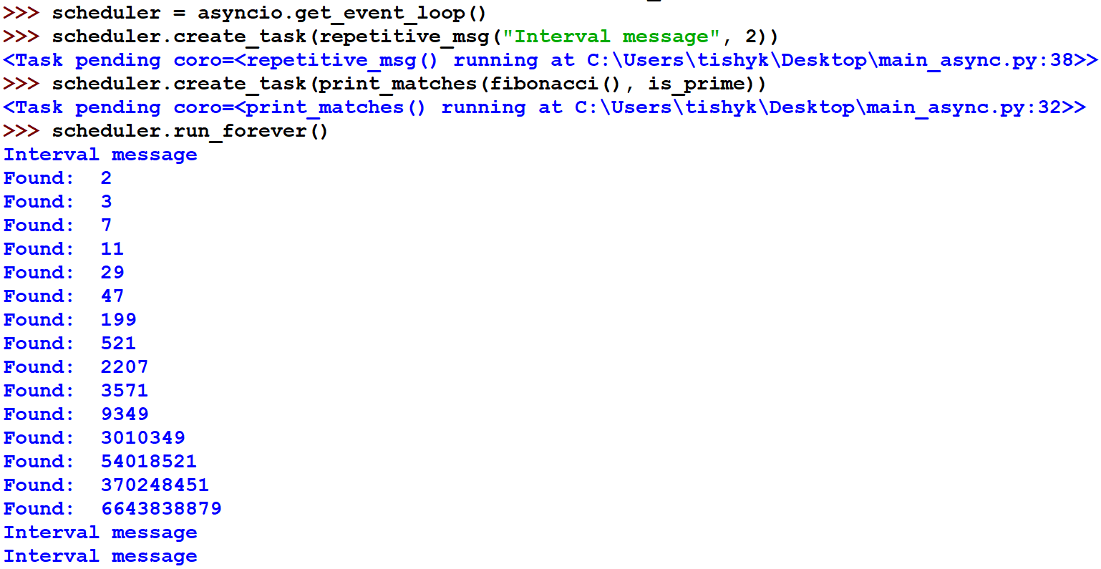
Coroutine, tasks and event-loops

Slide 38
Coroutine, tasks and event-loops
Coroutines implement tasks
Coroutines await other coroutines
Event-loop schedules concurrent tasks
Tasks must not block
Awaiting facilitates context switches
To yield control without needing a result await asyncio.sleep(0)

Slide 39
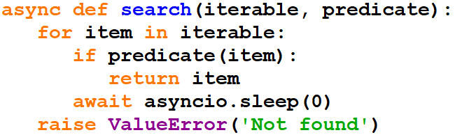
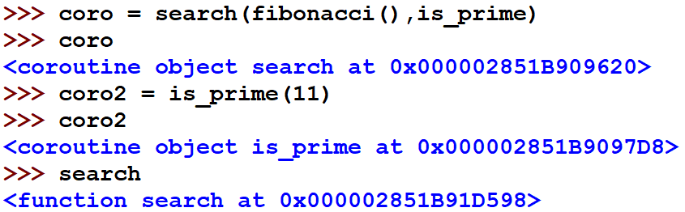
Coroutine, tasks and event-loops. Coroutine
Coroutine
code / callable
Coroutine object
code + execution state / awaitable

Slide 40
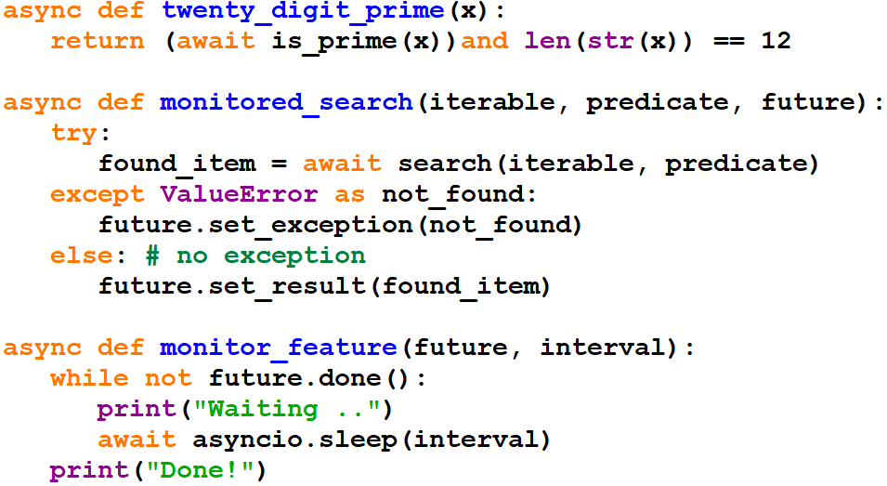
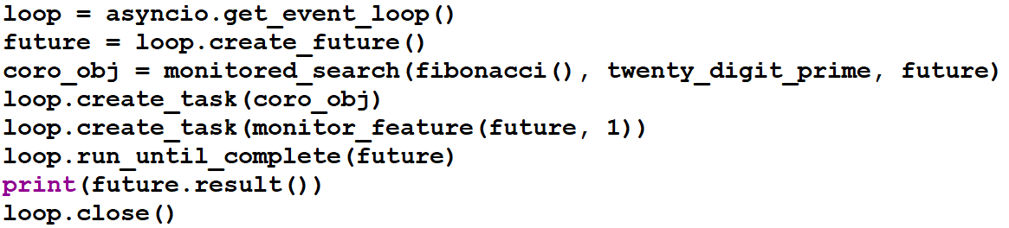
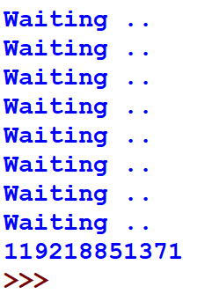
Coroutine, tasks and event-loops. Feature
Encapsulates a potential result or error

Slide 41
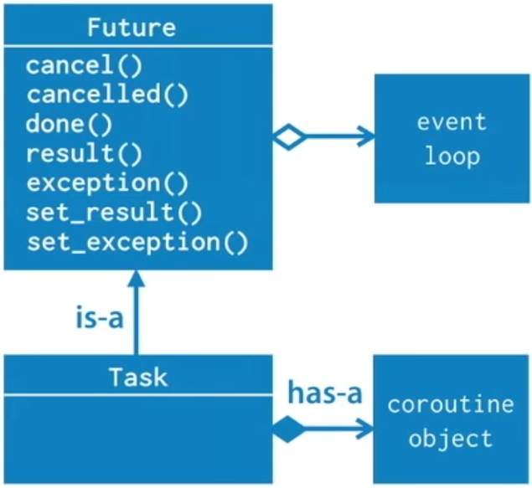
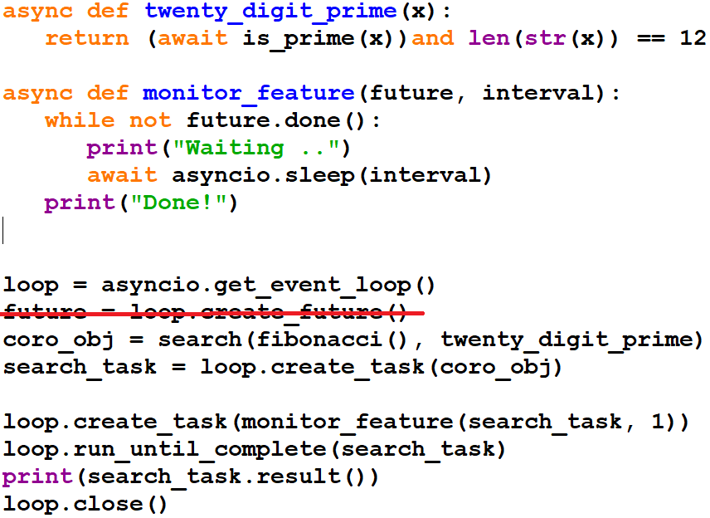
Coroutine, tasks and event-loops. Task
A subclass of a Future which wraps a coroutine

Slide 42
Coroutine, tasks and event-loops. Event loop
AbstractEventLoop interfaces:
run_forever()
run_until_complete(future)
stop()
is_closed()
shutdown_asyncgens()
create_future()
create_task(coroutine_object)

Slide 43
Дякую! Спасибо! Köszönjük! Дзякуй! Děkuji! Благодаря ти! Mulțumesc! Dziękuję Ci!
Thank You!

